Slide 1
Recommending Marketing Leads for YELP Businesses
Sahil Motadoo
Khushbu Mohta
Ravee Khandagale

Slide 2
Agenda
Objective Tools Project Flow Implementation and Integration Problems and Troubleshooting Results and Conclusion Demo

Slide 3
Objective
Help Yelp run Marketing Campaigns for the Businesses which are subscribed with them.
Generate a set of users who are likely to get service from a Business
Use Spark ML based Recommendation with ALS to predict users for business.
Categorize Businesses (To target and compare competitors)

Slide 4
Tools
Data Set : Yelp dataset Challenge, Nested JSON
Data Ingestion : Elastic Search v/s Amazon-S3
Spark ML : Stand Alone v/s Spark Service in MapR Sandbox
Visualization : Kibana v/s Re:dash

Slide 5
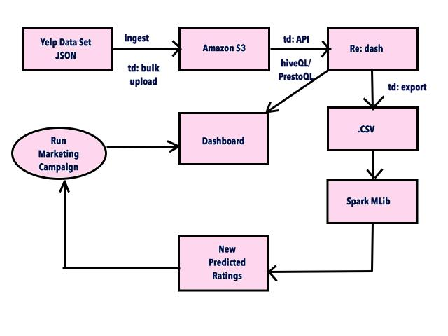
Project Flow

Slide 6
Implementation and Integration - Data Cleanup
Json Data dictionary :
Business
{'type': 'business', 'business_id':(encrypted business id), 'name': (business name), 'neighborhoods': [(hood names)], 'full_address': (localized address), 'city': (city),'state': (state), 'latitude': latitude,'longitude': longitude, 'stars': (star rating, rounded to half-stars), 'review_count': review count, 'categories': [(localized category names)] 'open': True / False, 'hours': {(day_of_week): {'open': (HH:MM),'close': (HH:MM)},...}, 'attributes': { … }

Slide 7
Implementation and Integration - Data Cleanup
Json Data dictionary :
user
{'type': 'user', 'user_id': (encrypted user id), 'name': (first name), 'review_count': (review count), 'average_stars': (floating point average, like 4.31), 'votes': {(vote type): (count)}, 'friends': [(friend user_ids)], 'elite': [(years_elite)], 'yelping_since': (date, formatted like '2012-03'), 'compliments': {(compliment_type): (num_compliments_of_this_type), ...}, 'fans': (num_fans), }
review
{'type': 'review', 'business_id': ( business id), 'user_id': (encrypted user id), 'stars': (star rating), 'text': (review text), 'date': (date,'2012-03-14'), 'votes': {(vote type): (count)}, }

Slide 8
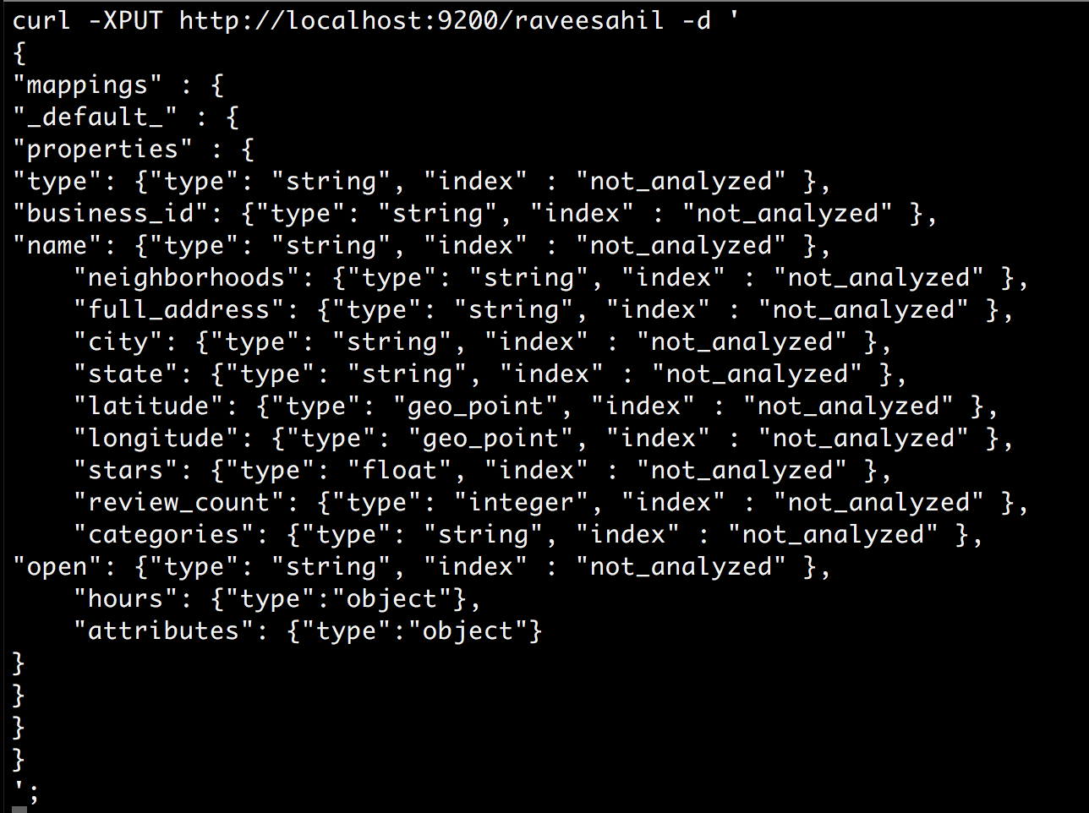
Implementation and Integration - Data Cleanup
Nested JSON
We tried using ElasticSearch to import JSON data (2GB) but the sandbox kept failing and were unsuccessful.
Notes:
Wanted to use Kibana.

Slide 9
Implementation and Integration - Data Cleanup
Nested Json, Large Dataset : FAIL !
Two alternatives: Parse Json and convert to some other format or Flatten Json using scripts - Too much work!
Decided to look for some tool that does not require tedious learning process
Treasure Data

Slide 10
Implementation and Integration - Data Cleanup
Sign up at Treasure Data for free trial (14-days)
Download td command-line tool, authenticate using email id
It has Amazon S3 bucket integrated to load data
Create tables and import data using command line
Sign up for Re:dash for a free trial (30-days)
Connect Re:dash to TD using API key
Issue Hive/Presto queries within Re:dash

Slide 11
Implementation and Integration - Spark MLib
Collaborative Filtering and Review Prediction
Predicted unknown rating values for users and business
All these predicted good ratings higher than 3.0 are Acquisition population, who are more likely to show interest in the business

Slide 12
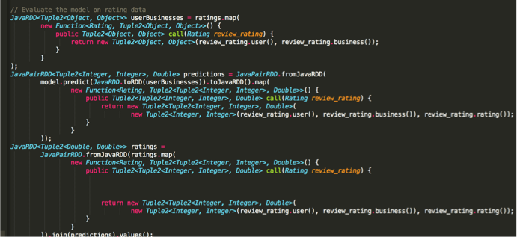
Implementation and Integration - Spark MLib

Slide 13
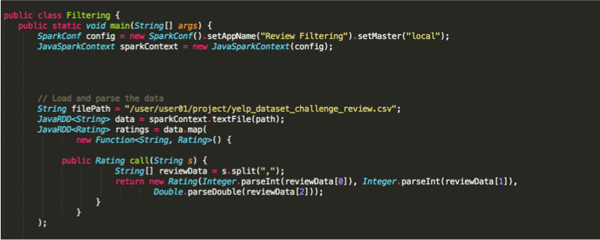
Implementation and Integration - Spark MLib

Slide 14
Implementation and Integration - Spark MLib
We started with a sample tutorial recommendation system for MovieLens data using Spark
Wrong way :
Right way :
->java -cp target/<name-of-jarfile> <name-of-main-method>
->/opt/mapr/spark/spark-1.6.1/bin/spark-submit --class <name-of-class> --master yarn <name-of-jar>

Slide 15
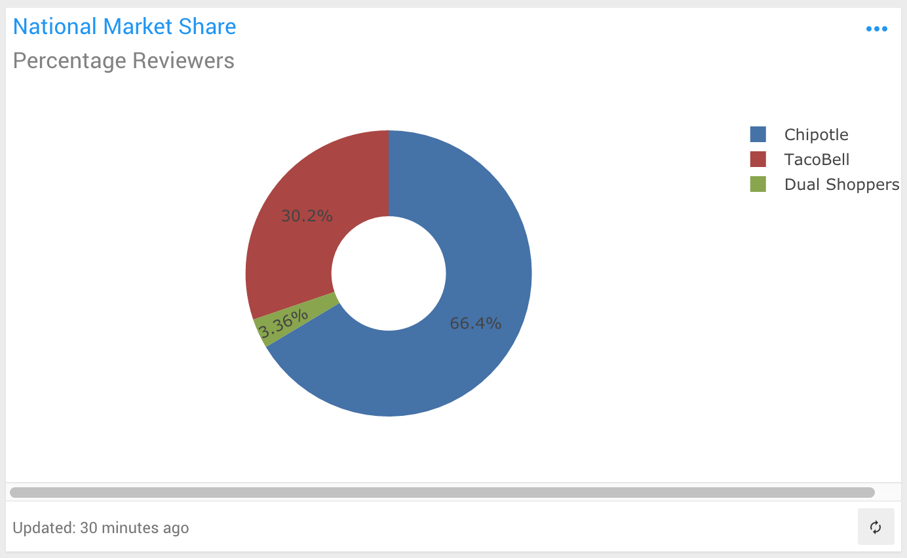
Data Visualization
Connect Re:dash to Treasure Data’s API to draw some insights

Slide 16
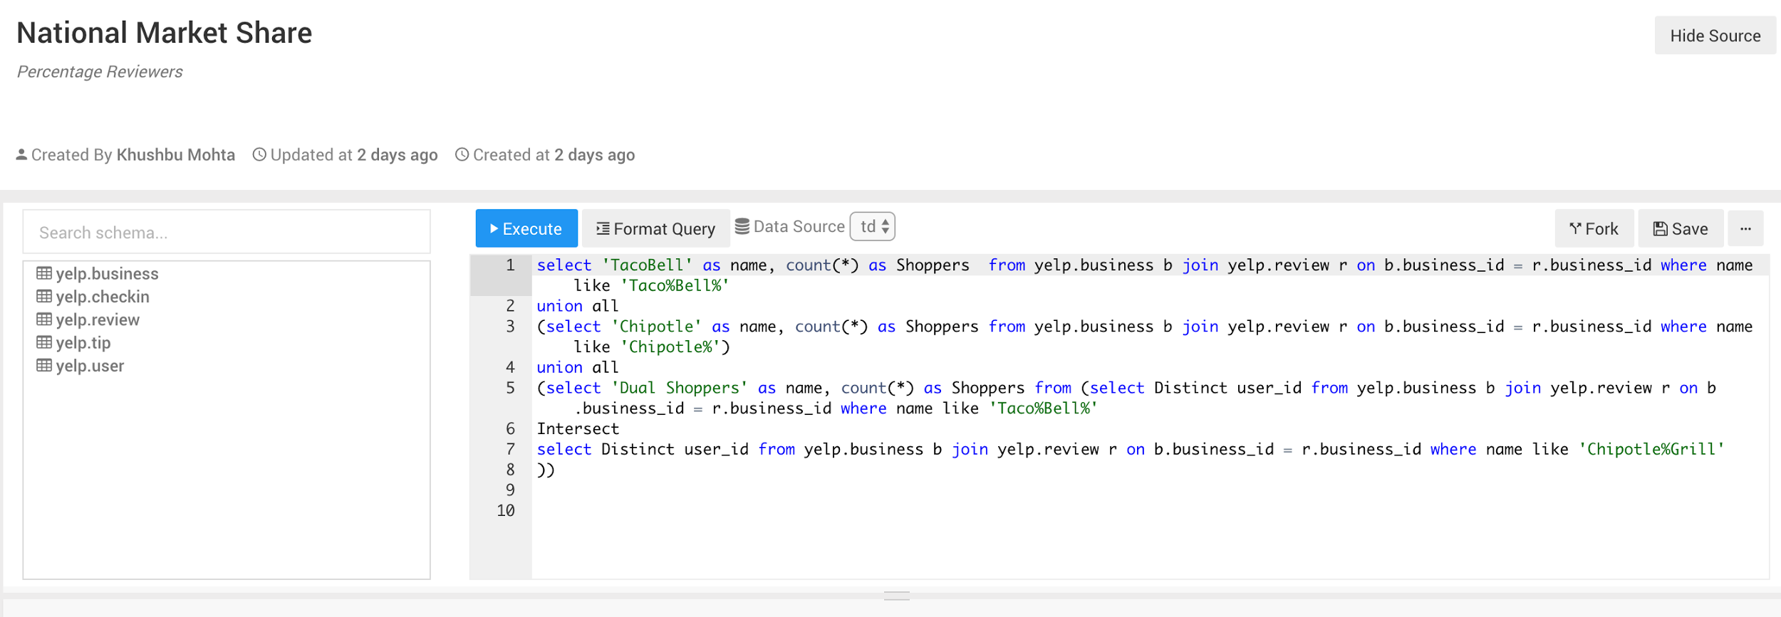
Data Visualization
Connect Re:dash to Treasure Data’s API to draw some insights

Slide 17
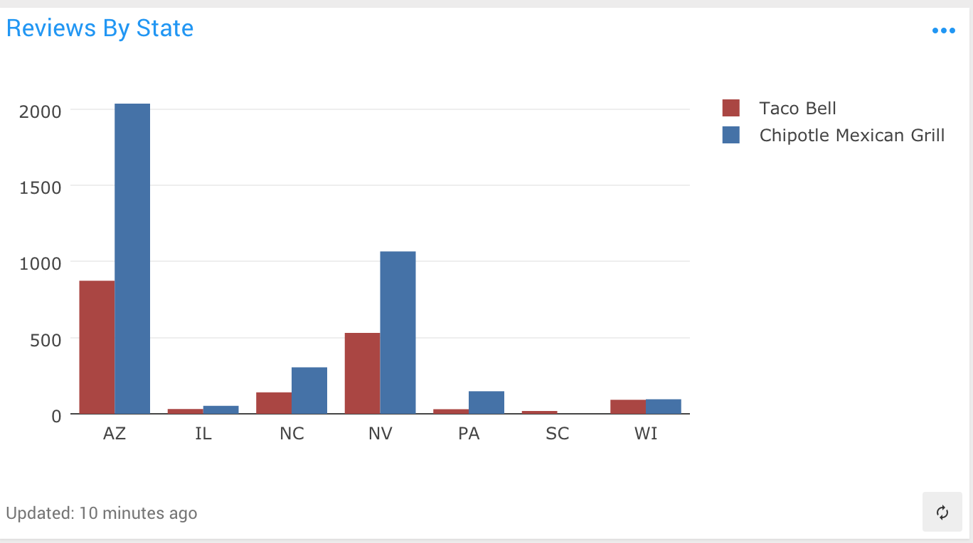
Data Visualization
Connect Re:dash to Treasure Data’s API to draw some insights

Slide 18
Conclusion and Future Works
This helps acquire new customer for businesses
Yelp gets more revenue based on Incremental Sales it brings to its clients through these campaigns
There can be customer specific dashboards where they can see, their market share changing with competitors.
With live stream of reviews, it can show marketing campaign effectiveness

Slide 19
Demo

